Slide 1
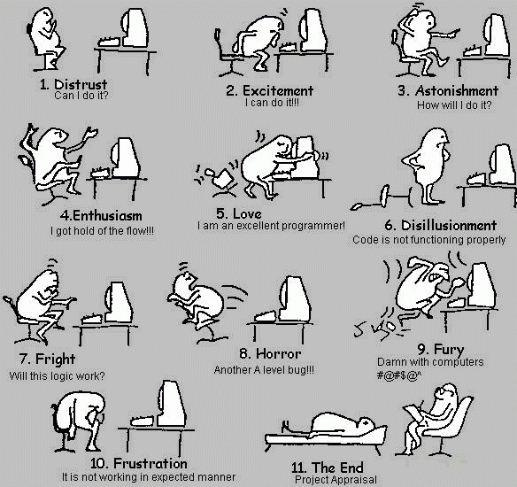
CSCI 1300 Starting Computing
Recitation 1

Slide 2
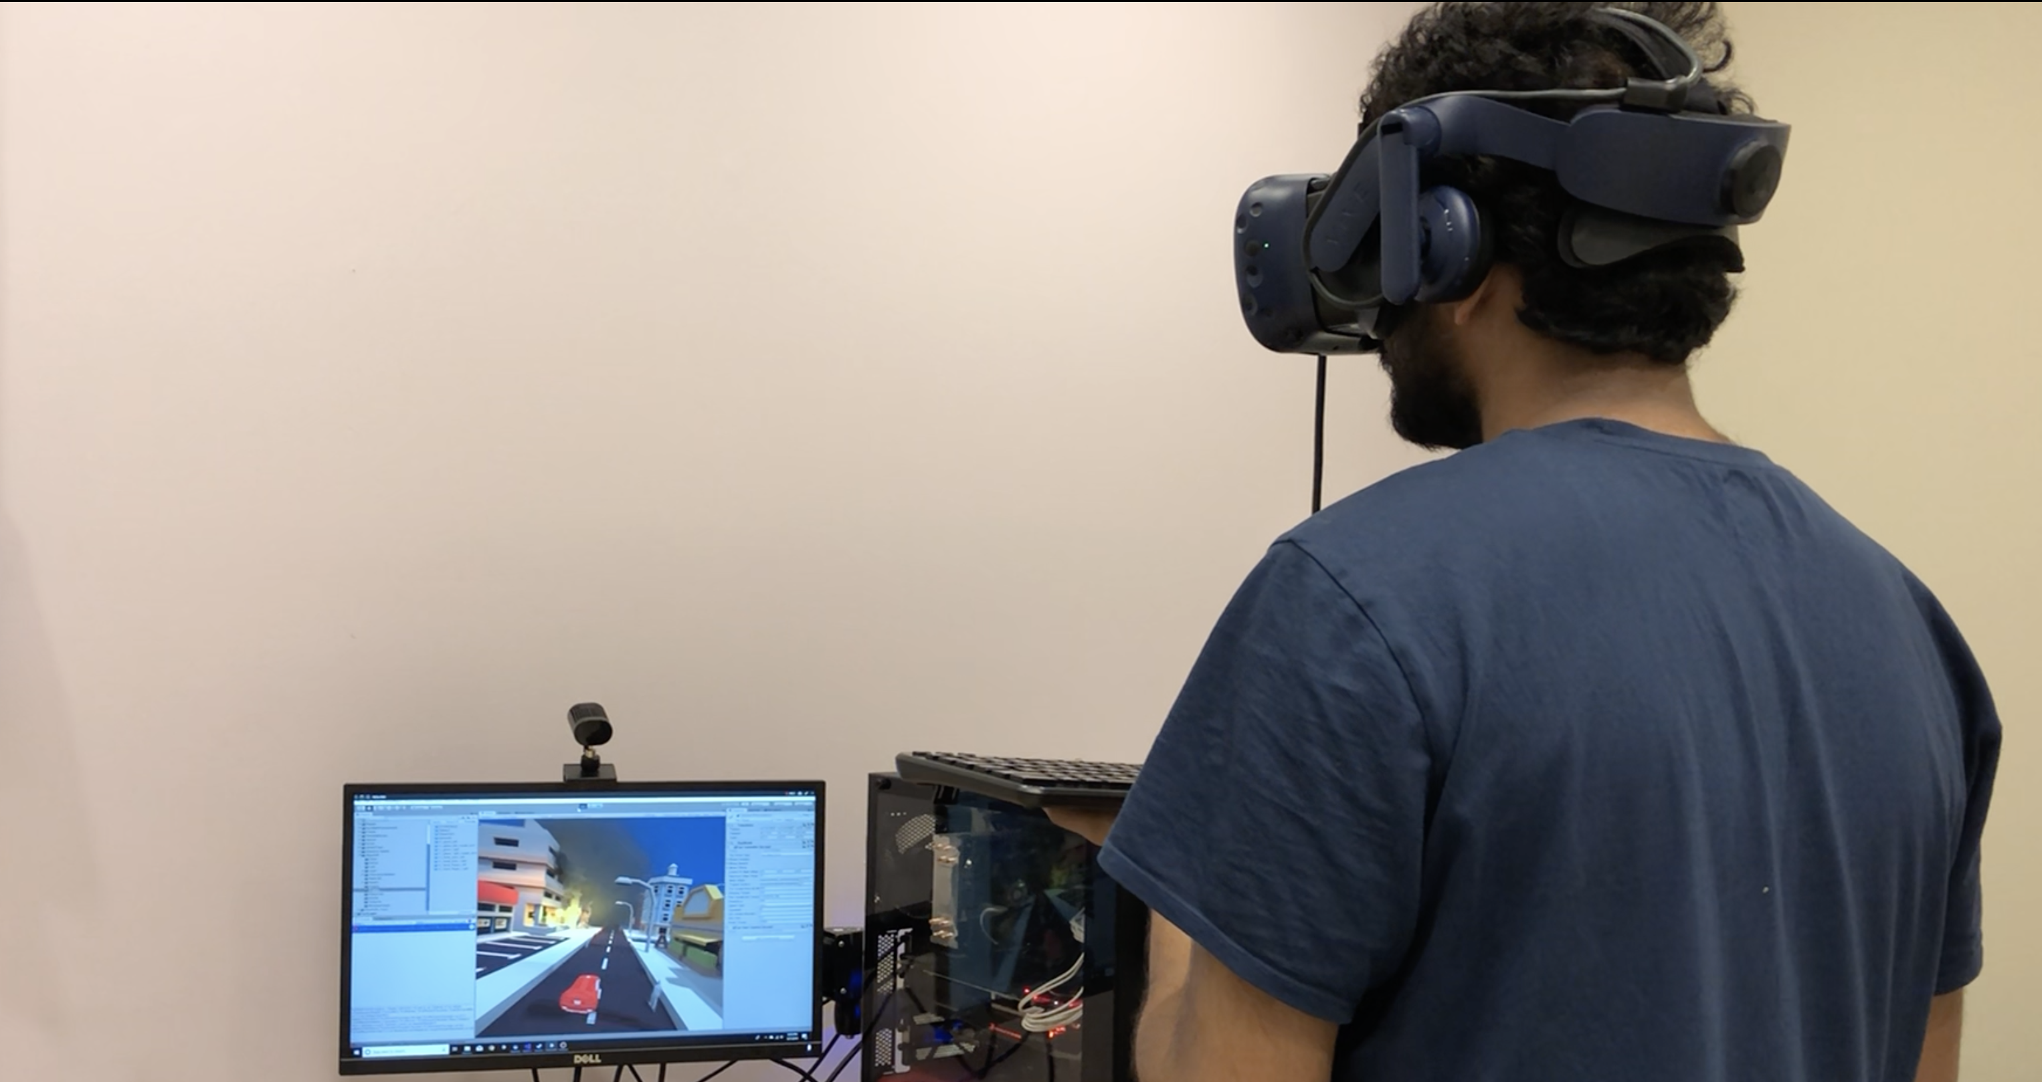
About Me
Karthik Palavalli
From Bangalore, India
2nd Year Masters
B.E. in Information Science
NLP, Robotics
Office Hours
Tuesday, 6 to 8 PM (this week 6:30 to 8:30)
TBD – will be updated every week on the calendar
Email: karthik.palavalli@colorado.edu

Slide 3
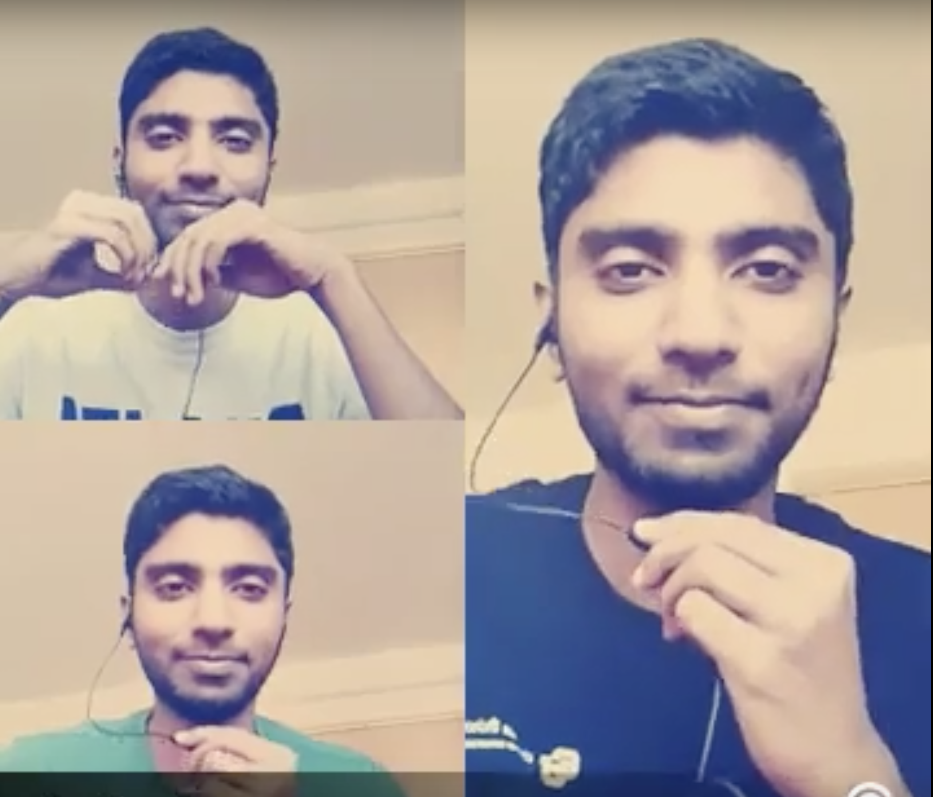
Your Real TA: section 106
Sravanth Yajamanam
From India
2nd Year Master’s student
Smart
Sings and dances
Email: sravanth.yajamanam@colorado.edu

Slide 4
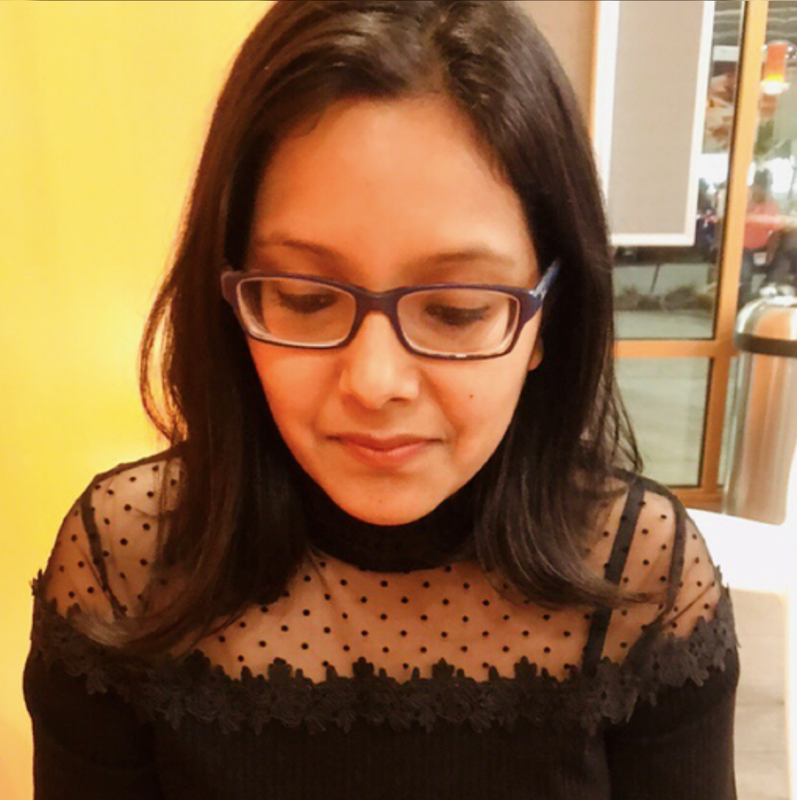
Your Real TA: section 107
Shipra Behra
From India
2nd Year Master’s student
Smart
Very Helpful
Email: shipra.behera@colorado.edu

Slide 5
About Recitation
Mandatory
There are points linked to homeworks
If you need to miss recitation, make arrangements to go to another recitation, with both TAs.
Always bring a laptop
15-20 mins lecture
Homework / Questions

Slide 6
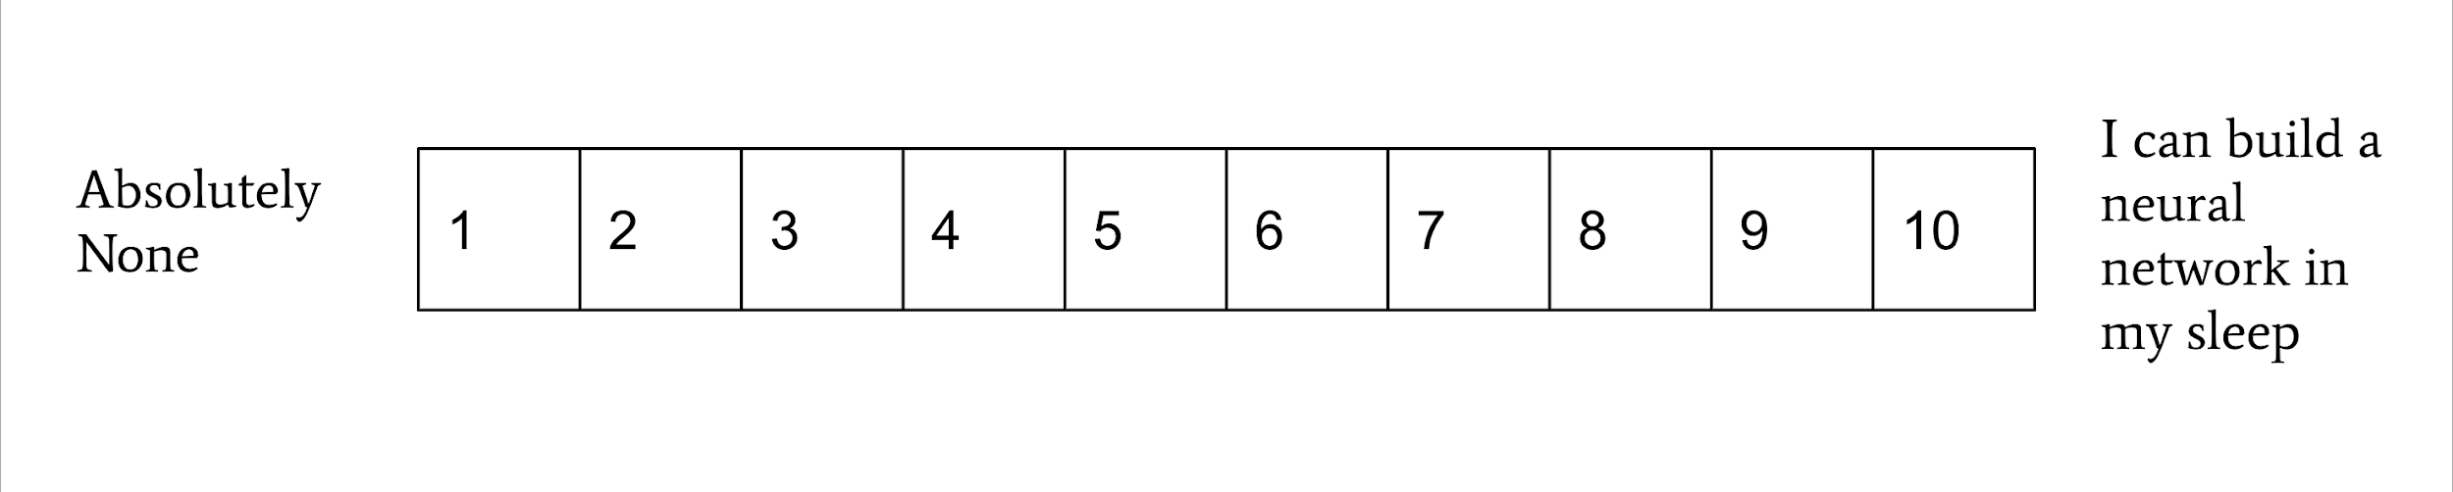
Getting To Know You
Name
Major
Programming Experience, scale 1 to 10
What do you expect to learn from this course

Slide 7
Environment Setup
Moodle
Key: CSCI1300Spring2020
Cloud 9
Make sure you are part of my class
Check your CU email for an invite
VSCode
Install the software
Install C++ compiler if needed (PCs mostly need it)
Notes:
Give a tour of Moodle, where the TA calendar is, how to find and submit the homework

Slide 8
Homework 0
Hello World on Cloud9 and VSCode
Include screenshots of both in your submission
Read the instructions carefully!
Submit hmwk0_yourLastName.zip by the link
Due Saturday by 6pm on Moodle
Friday by 6pm: Extra Credit
Notes:
Who has started HW 0?
Okay let's all do it together

Slide 9
Basic Linux Commands
ls - list
mkdir - make directory
cd - change directory
cd .. - go to the parent
cp source destination - copy files from source to destination
mv source destination - move files from source to destination
zip filename source - zip files to filename
unzip file.zip - unzip a zip file
What if I forget how to use the commands?
Google it!

Slide 10
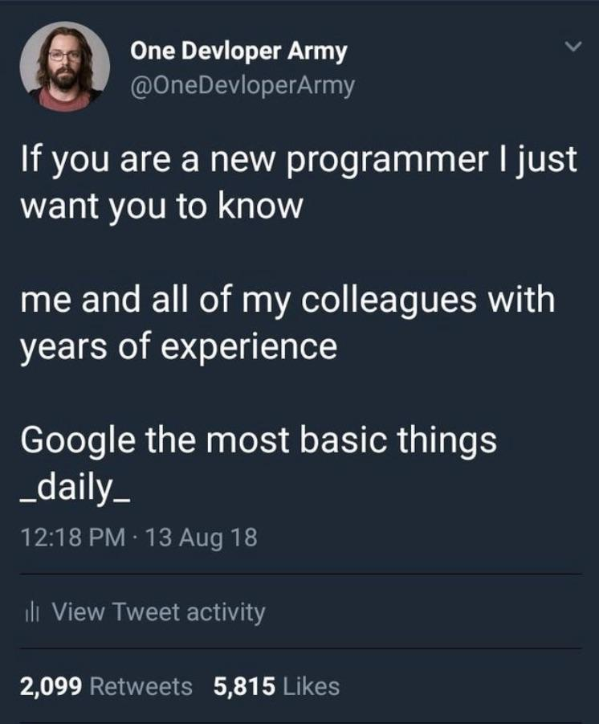
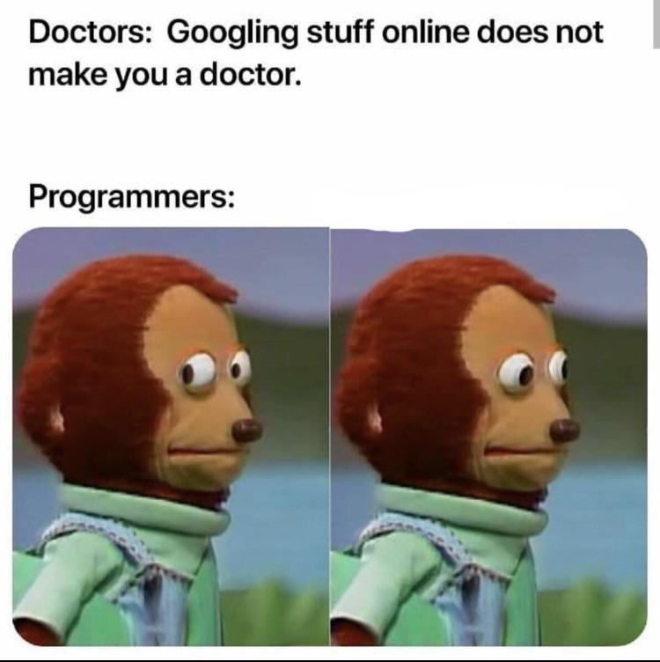
Tips
If you have a problem, Google it first.
Tab complete file names in bash
man : command to see manual of other command

Slide 11
Reminder
Homework 0 due on Saturday by 6pm

Slide 12
Questions?

